Slide 1
CHAPTER-2
ACIDS,BASES AND SALTS

Slide 2
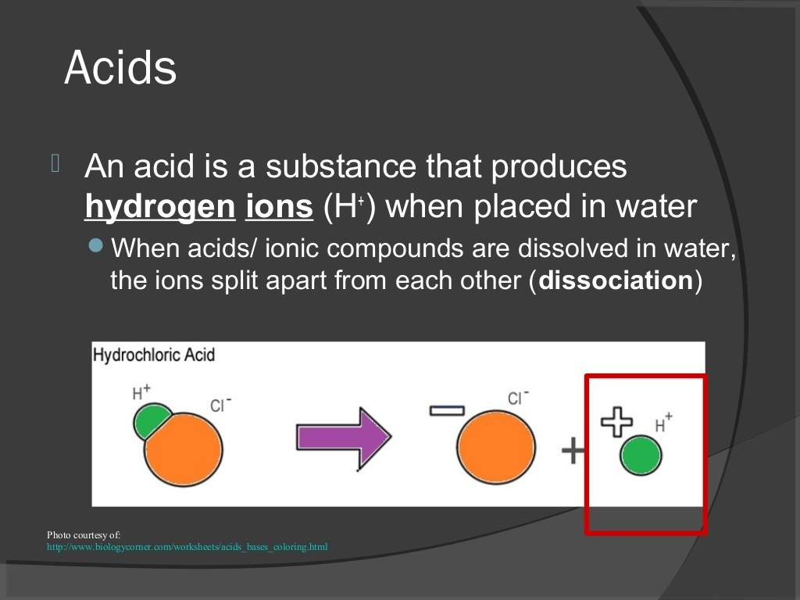

Slide 3
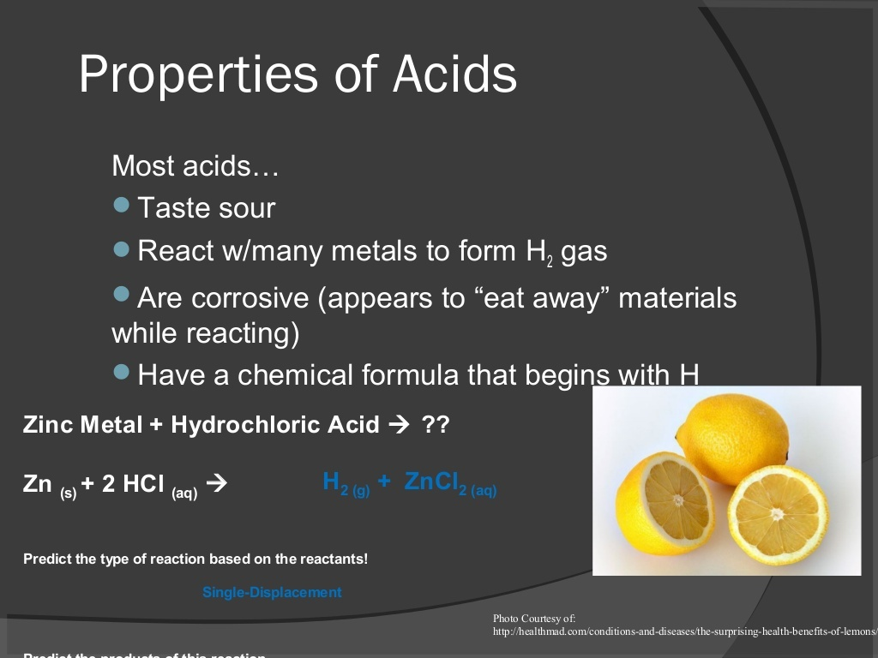

Slide 4
Common Acids :
1.Acetic acid
(CH3COOH)
2.Citric acid
(C6H8O7)
3.Formic acid
(HCOOH)
1.Hydrochloric acid (HCl)
2.Sulphuric acid (H2SO4)
3.Nitric acid (HNO3)

Slide 5
CLASSIFICATION OF ACIDS :
Acids can be classified as-
(i)Organic Acids- acids which are present in plants and animals.example:Acetic Acid,Formic acid
(ii)Inorganic Acid: Acids which are obtained from rocks and minerals.example-HCl,Nitric acid,sulphuric acid

Slide 6
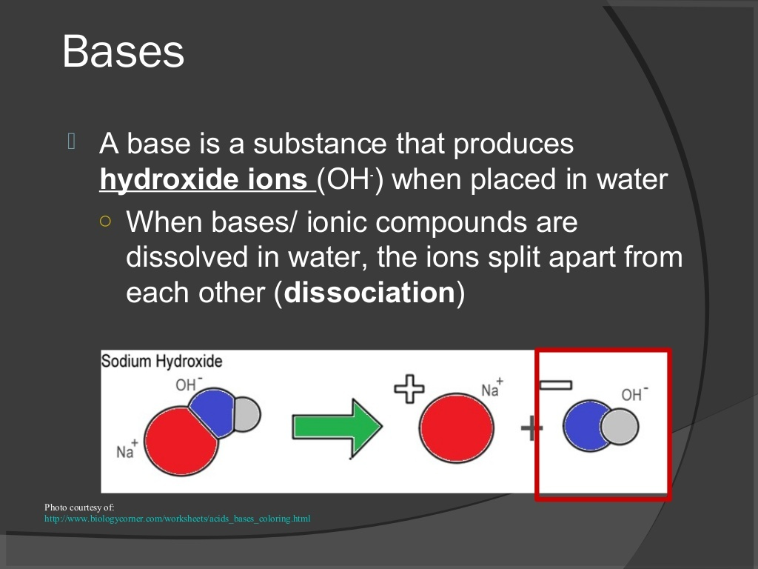

Slide 7
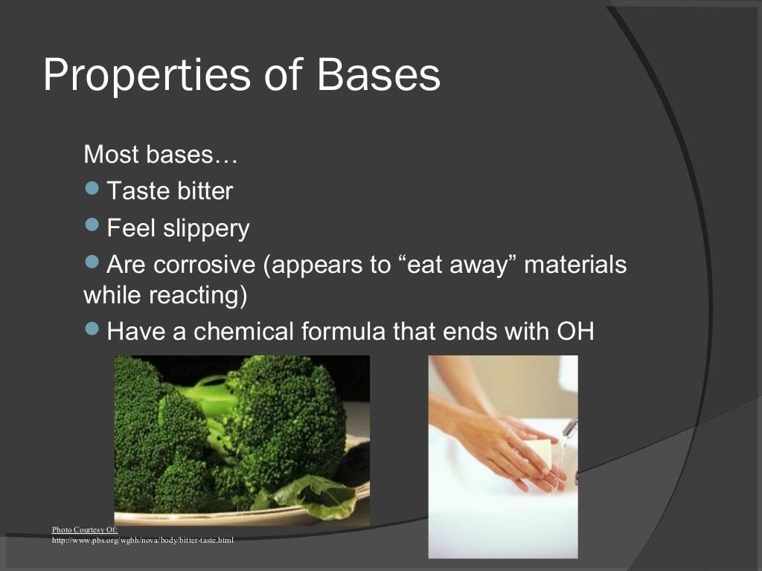

Slide 8
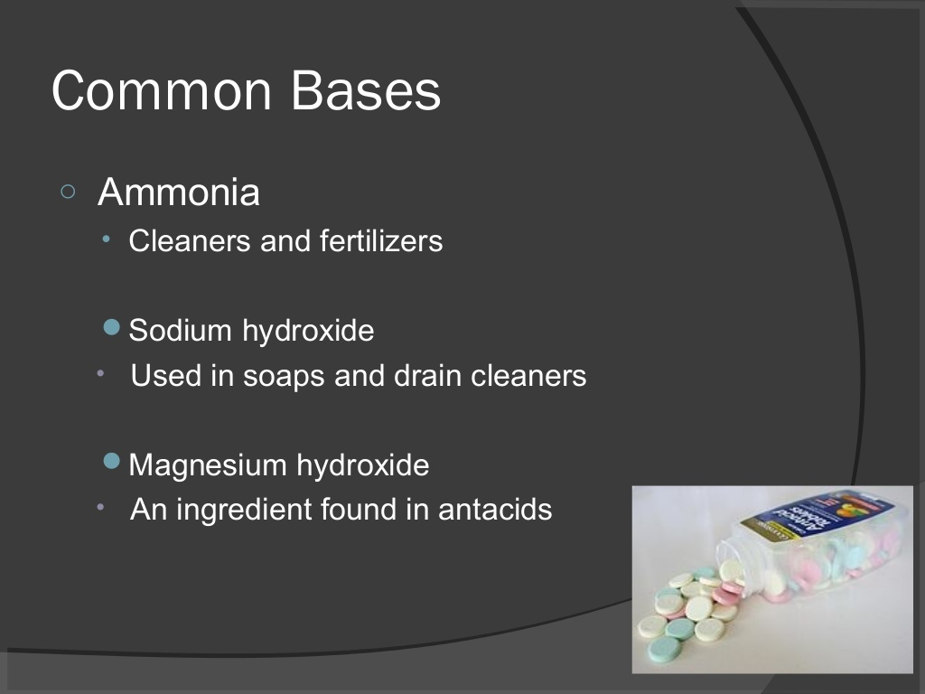
Notes:
sdsdsdsdss

Slide 9
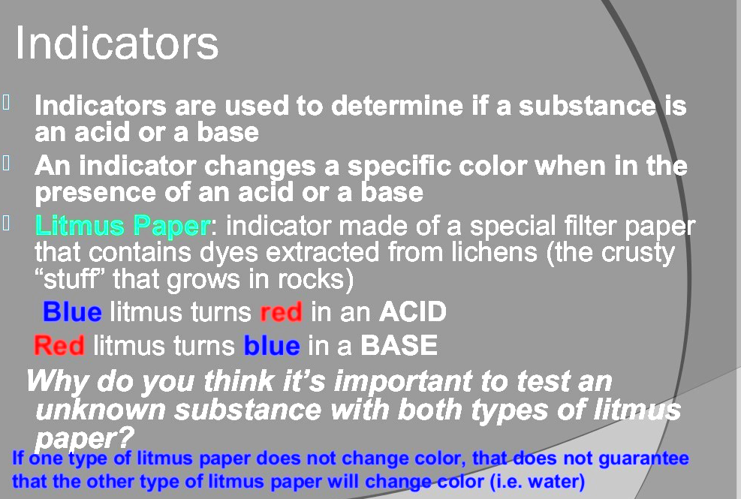

Slide 10
TYPES OF INDICATORS:
(i) Indicators showing different colours in acidic and basic medium------
(a)Natural indicator-Litmus paper, Red
cabbage
(b)Synthetic indicator-Phenolphthalein,Methyl
orange
(ii) Indicators giving different odours in acidic and basic medium(olfactory indicator)--onion,clove oil

Slide 11
1. You have been provided with three test tubes. One of them contains distilled water and the other two contain an acidic solution and a basic solution, respectively. If you are given only red litmus paper, how will you identify the contents of each test tube?

Slide 12
REACTION OF METALS WITH ACIDS AND BASES:
WITH ACIDS------
Zn(s) + H2SO4(aq) → ZnSO4(aq) + H2(g)
Zn(s) + 2HCl(aq) → ZnCl2(aq) + H2(g)
WITH BASES-----
Zn+NaoH→Na2ZnO2+H2

Slide 14
Na2CO3+ 2HCl------->2NaCl+ H2O+CO2
NaHCO3 +HCl-------->NaCl+H2O +CO2
TEST FOR CARBON DI-OXIDE
Ca(OH)2 +CO2------->CaCO3 +H2O
lime water (insoluble in water)
CaCO3 +H2O+CO2------> Ca(HCO3)2
(soluble in water)
REACTION OF ACIDCS AND BASES WITH METAL CARBONATES AND BICARBONATES:

Slide 15
4
REACTION OF ACIDS WITH BASES:
Neutrilisation reaction :
NaOH +HCl---->NaCl +H2O
H2SO4 +2NaOH---->Na2SO4 +2H2O

Slide 16
Reaction of Metallic Oxides with Acids :
Al2O3 +6HCl---> AlCl3 +3H2O
ZnO+ H2SO4--->ZnSO4 +H2O

Slide 17
Reaction of non-metallic oxide with base :
CO2 +Ca(OH)2---> CaCO3 +H2O

Slide 18
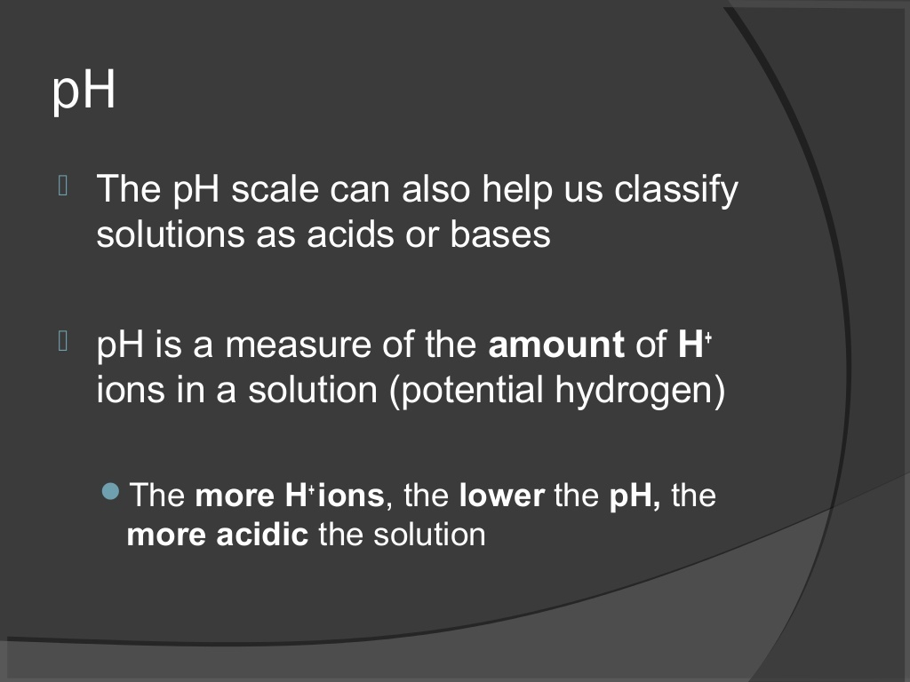

Slide 19
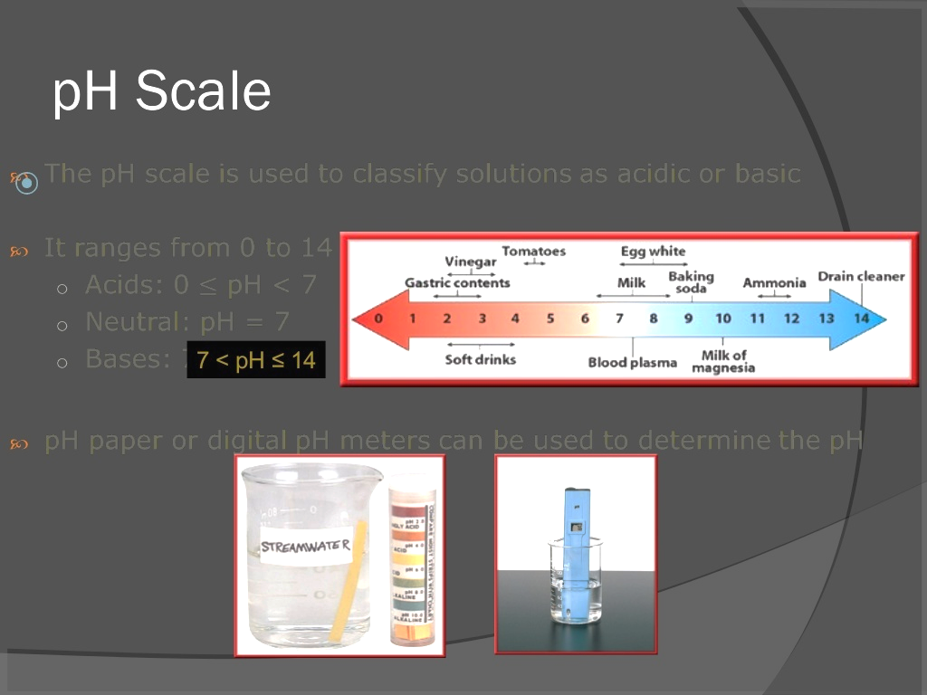

Slide 20
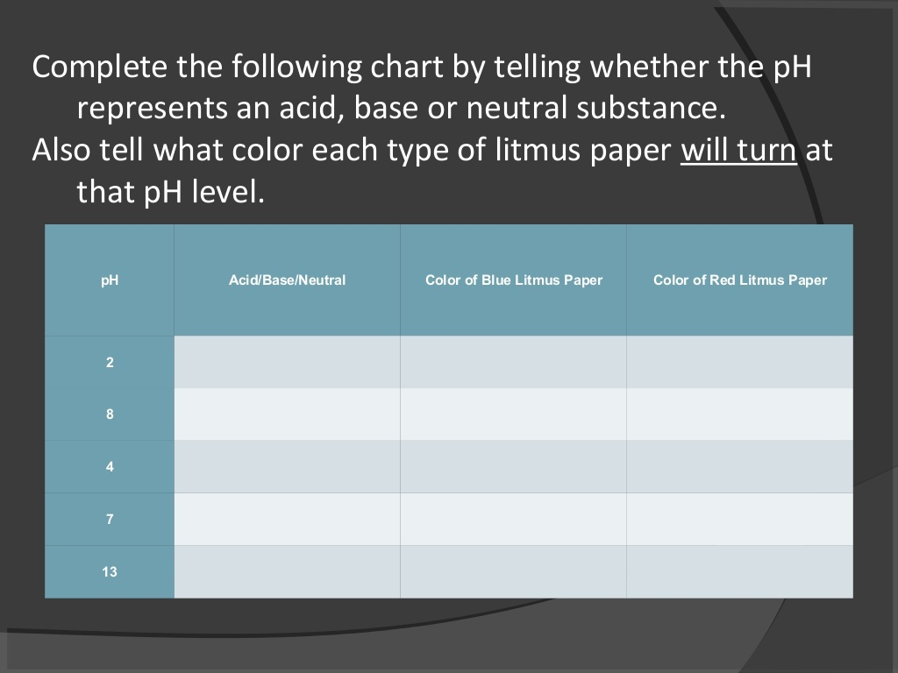

Slide 21
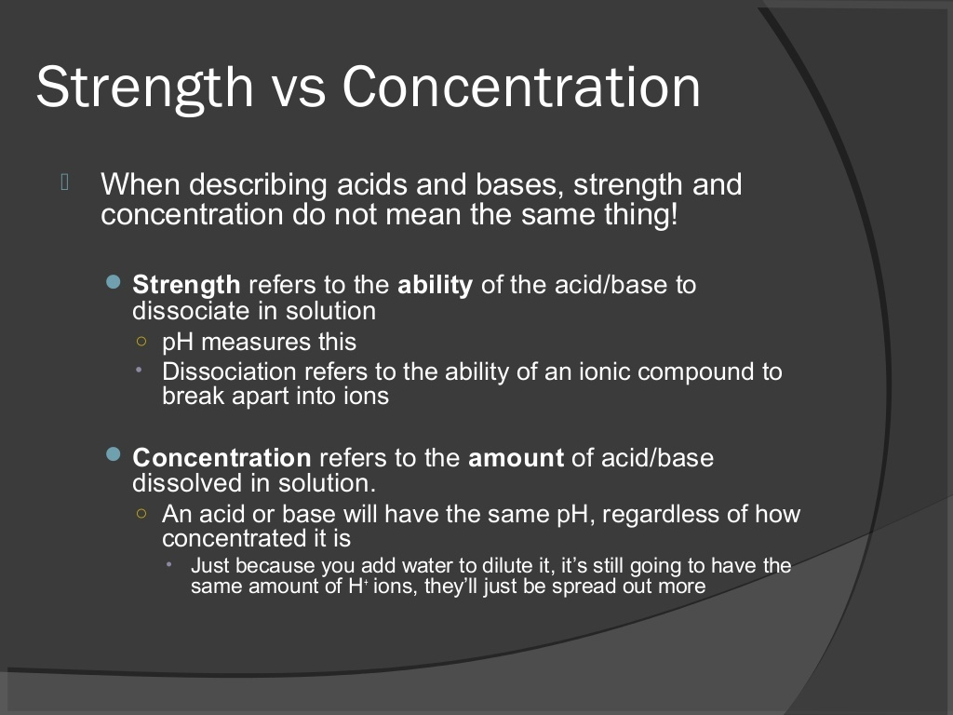

Slide 22
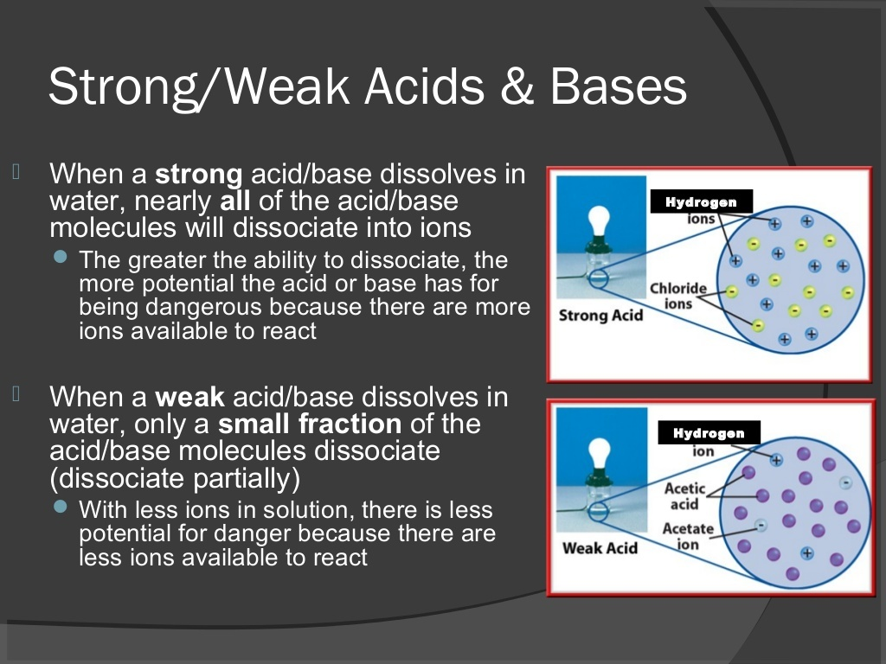

Slide 23
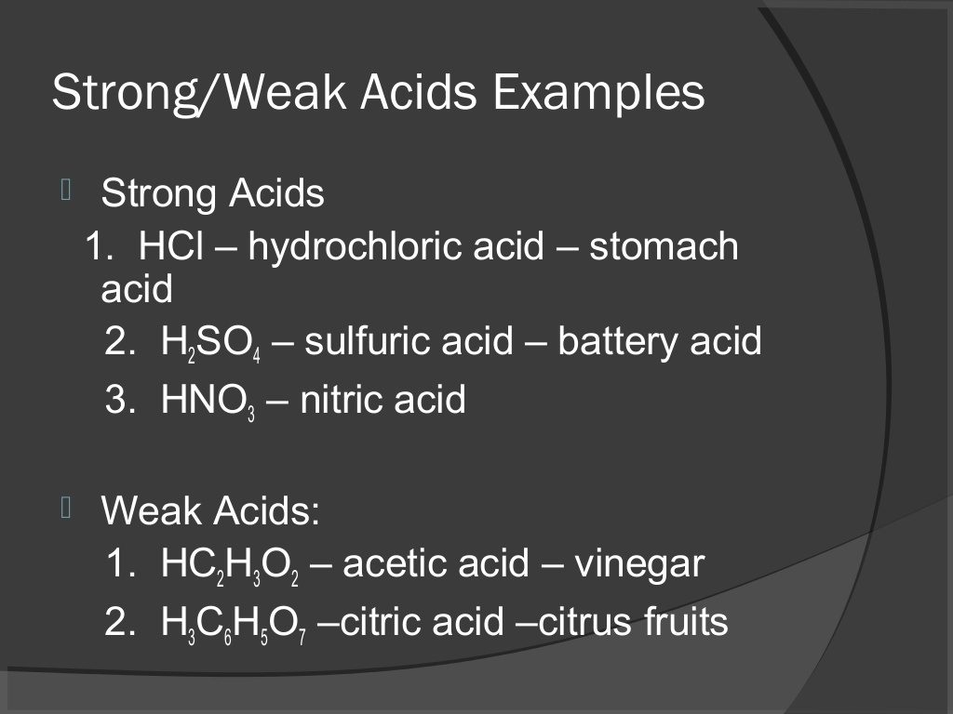

Slide 24
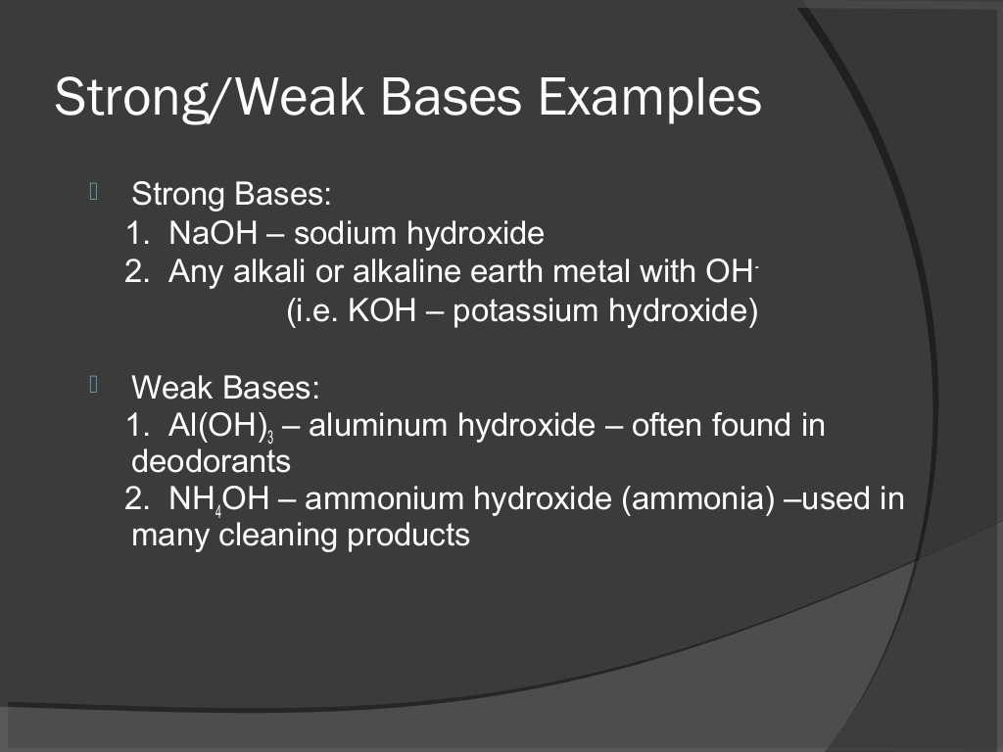

Slide 25
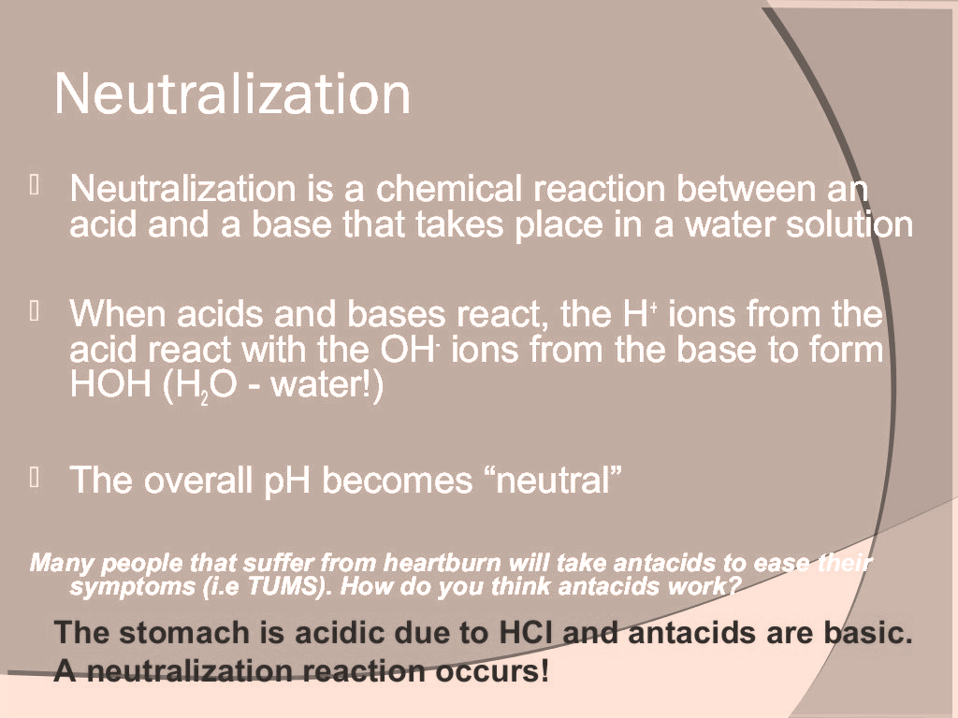

Slide 26
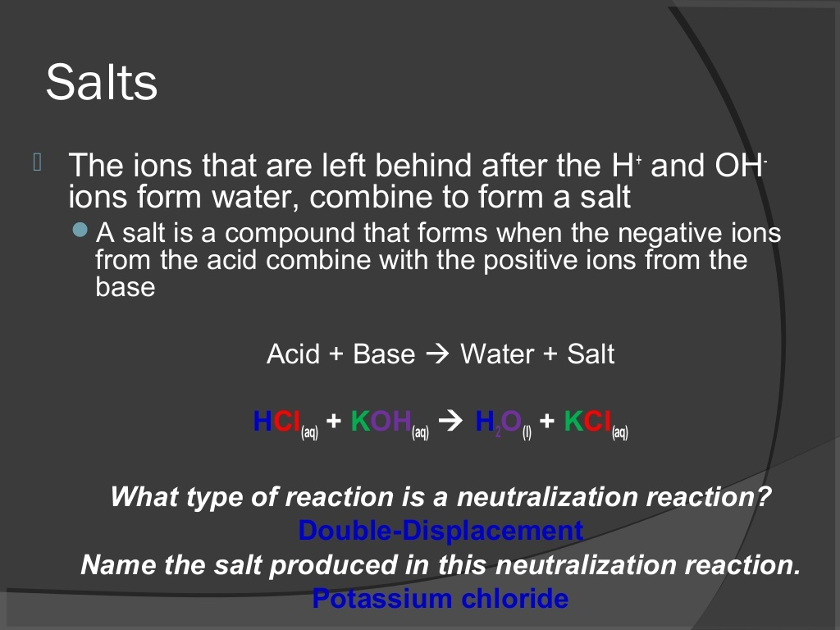

Slide 27
Chemicals fron Common Salt
NaOH
(Caustic Soda)
CaOCl2
(Bleaching powder)
NaHCO3
(Baking Soda)
Na2CO3.10H2O
(Washing Soda)

Slide 28
Preparation
NaOH
2NaCl +2H2O 2NaOH+H2 +Cl2
CHLOR-ALKALI PROCESS
(Electrolysis of Brine Solution)

Slide 29
Uses Of NaOH
Uses of Chlorine
1. soaps and detergent
2.paper industry
3.as a laboratory reagent
As disinfectant
making PVC(polymer)
CFC,DDT
Uses of H2
1.hydrogenation of vegetable oil
2.As a fuel

Slide 30
Preparation
Bleaching Powder
chemical name: Calcium oxy chloride
Ca(OH)2 +Cl2 CaOCl2+H2O

Slide 31
Uses of Bleaching Powder
textile industry for bleaching cotton and linen
paper industry for bleaching wood pulp
as a disinfectant

